Slide 1

RAJA BALWANT SINGH ENGINEERING TECHNICAL CAMPUS BICHPURI, AGRA
PROJECT PROGRESS PRESENTATION
AgroGuide - Your Farming Companion Application
Presented To: Presented By:
Department of Computer Science Masroor Majeed Mir (2000040100048)
& Engineering

Slide 2
CONTENTS
AgroGuide - Your Farming Companion Application
About the Project
Hardware and Software
Project Phases
System Architecture
Data Flow Diagram
Testing Technologies and Security Mechanisms
Limitation & Challenges
Snapshots
References

Slide 3
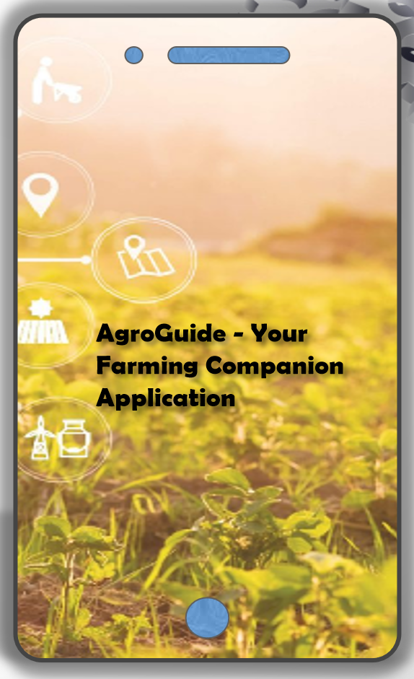
AgroGuide - Your Farming Companion Application
Revolutionizing Crop Selection with Machine Learning

Slide 4
About the Project
Project Objective:
AgroGuide's primary goal is to assist farmers in making data-driven decisions for crop selection.
The objective is to optimize yield and resource usage in agriculture.
Key Features:
Crop recommendations powered by machine learning.
Comprehensive application offering soil analysis.
User-friendly interface for precision and efficiency in crop planning.

Slide 5
Hardware and Software
Hardware:
Processor: Intel Core i5 or higher.
RAM: 8 GB or more.
Hard Disk: 120 GB.
Input Devices: Mouse, Keyboard, Smartphone.
Software:
Operating System: MacOS, Windows 10/11.
Programming Language: Python, Java.
Special Tools: Google Colab, PyCharm, Android Studio.

Slide 6
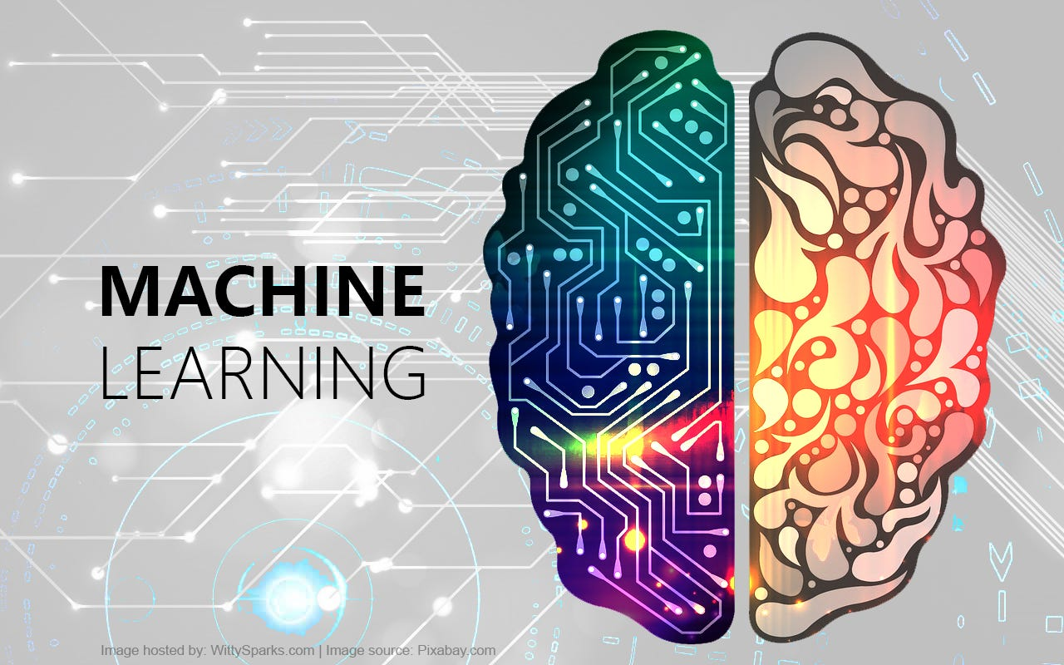
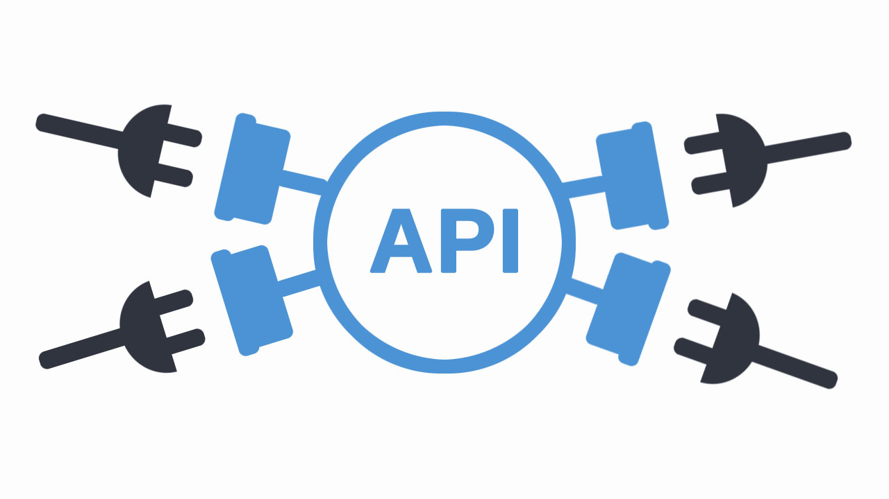
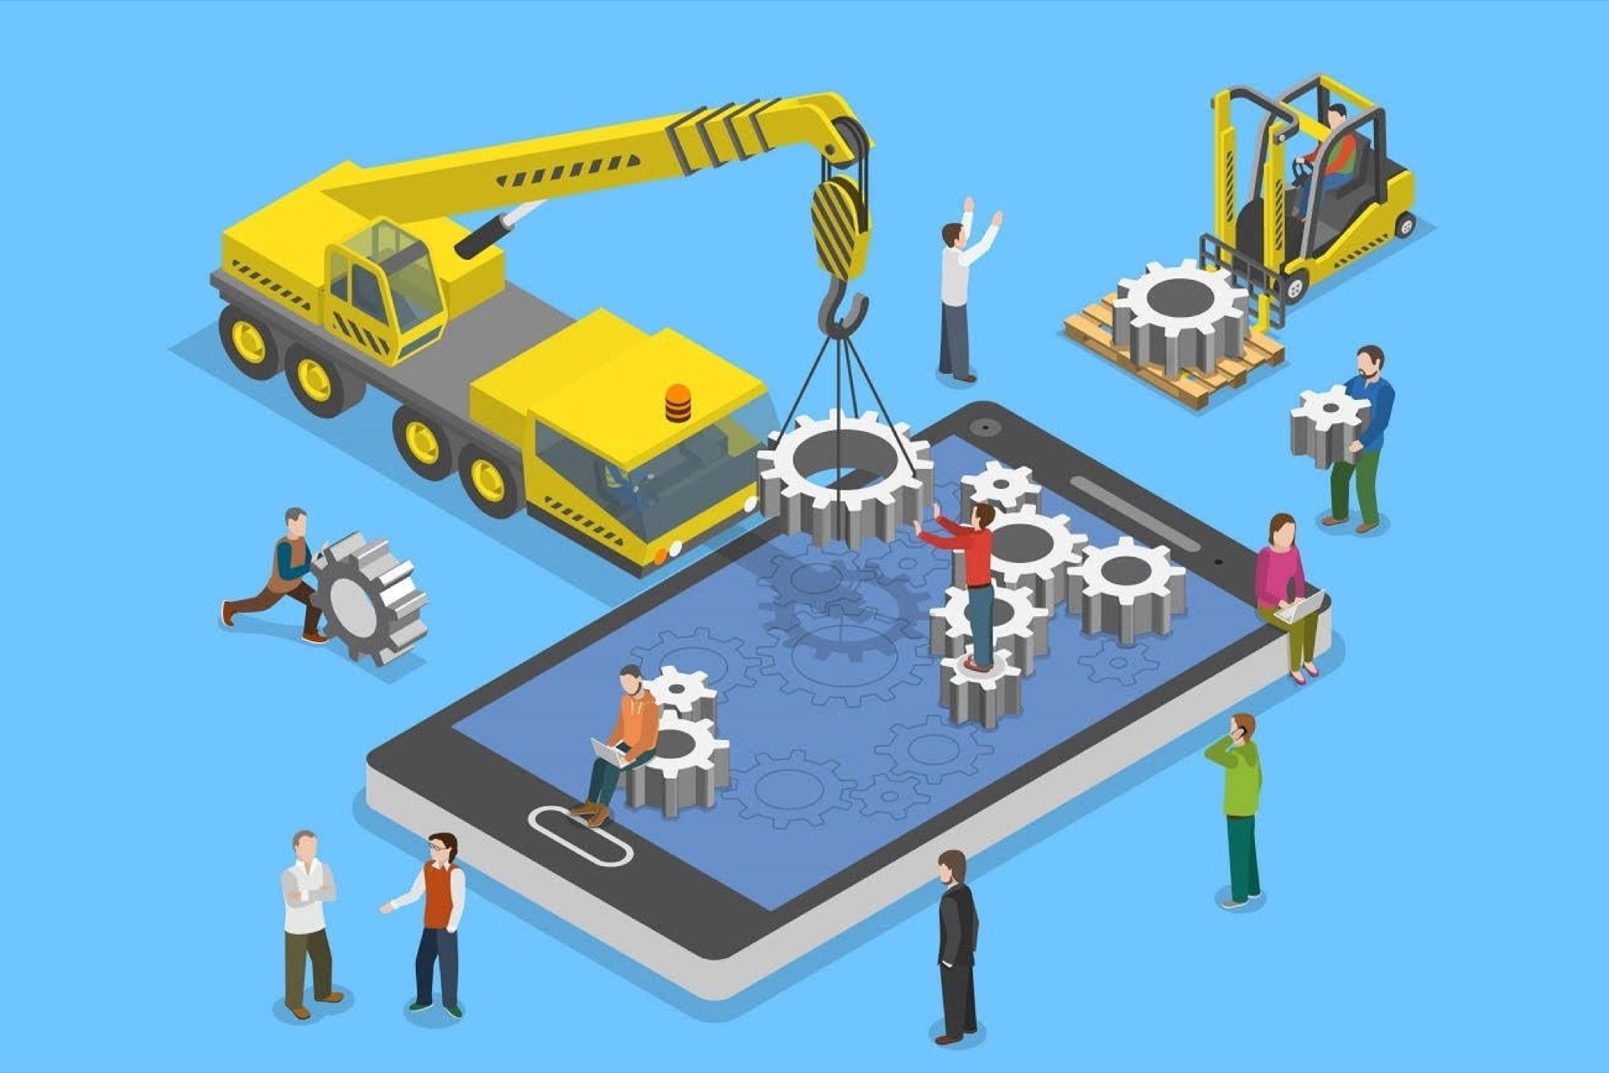
Project Phases
Stage 1:
Stage 2:
Stage 3:
Developing Machine Learning Model
Convert into Flask RESTful API
Building an Android Application

Slide 7
Stage 1
Background
Developing Machine Learning Model
Objective:
Create and train machine learning models to analyze agricultural data.
Activities:
Collecting and preprocessing agricultural data.
Selecting and training models
Evaluating model performance and accuracy.
Tools & Technologies:
Python
Scikit-Learn
Jupyter Notebook
Provide necessary background information.

Slide 8
Stage 2
Convert into Flask RESTful API
Objective:
Develop a Flask-based API to serve the machine learning model predictions.
Activities:
Designing API endpoints for data input and output.
Integrating trained machine learning models with Flask.
Ensuring API security and scalability.
Tools & Technologies:
Flask
Python
Docker (optional for containerization)
Postman (for API testing)

Slide 9
Stage 3
Building an Android Application
App Design and Layout:
Design user interface for the Android app.
Create layouts for input and displaying recommendations.
User Input and Submission:
Implement forms for users to input data.
Validate user input for accuracy.
API Integration in Android App:
Develop functionality to communicate with the Flask API.
Send user input and receive crop recommendations.

Slide 10
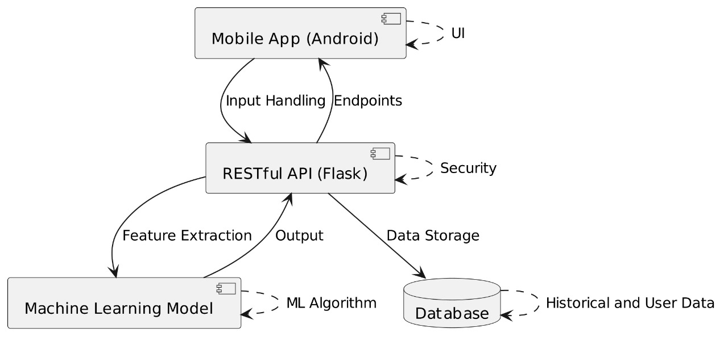
System Architecture

Slide 11
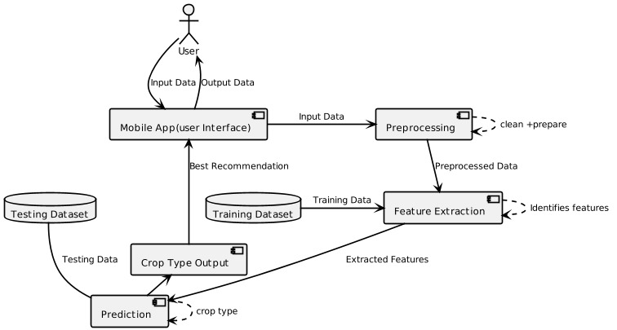
Data Flow Diagram

Slide 12
Testing Technologies and Security Mechanisms
Testing Types
Unit Testing: Validate individual components.
Integration Testing: Ensure components work seamlessly.
Security Mechanisms
Input Validation: Prevent injection attacks.
Authentication and Authorization: Ensure secure access.
Secure APIs: Protect data integrity and confidentiality.

Slide 13
Limitation &Challenges
Limitation
Data Quality and Availability.
Internet Connectivity Dependency.
Geographical Specificity.
Anticipated Challenges:
Ensuring data quality and availability.
Addressing geographical specificity.
Balancing device compatibility and resource constraints.

Slide 14
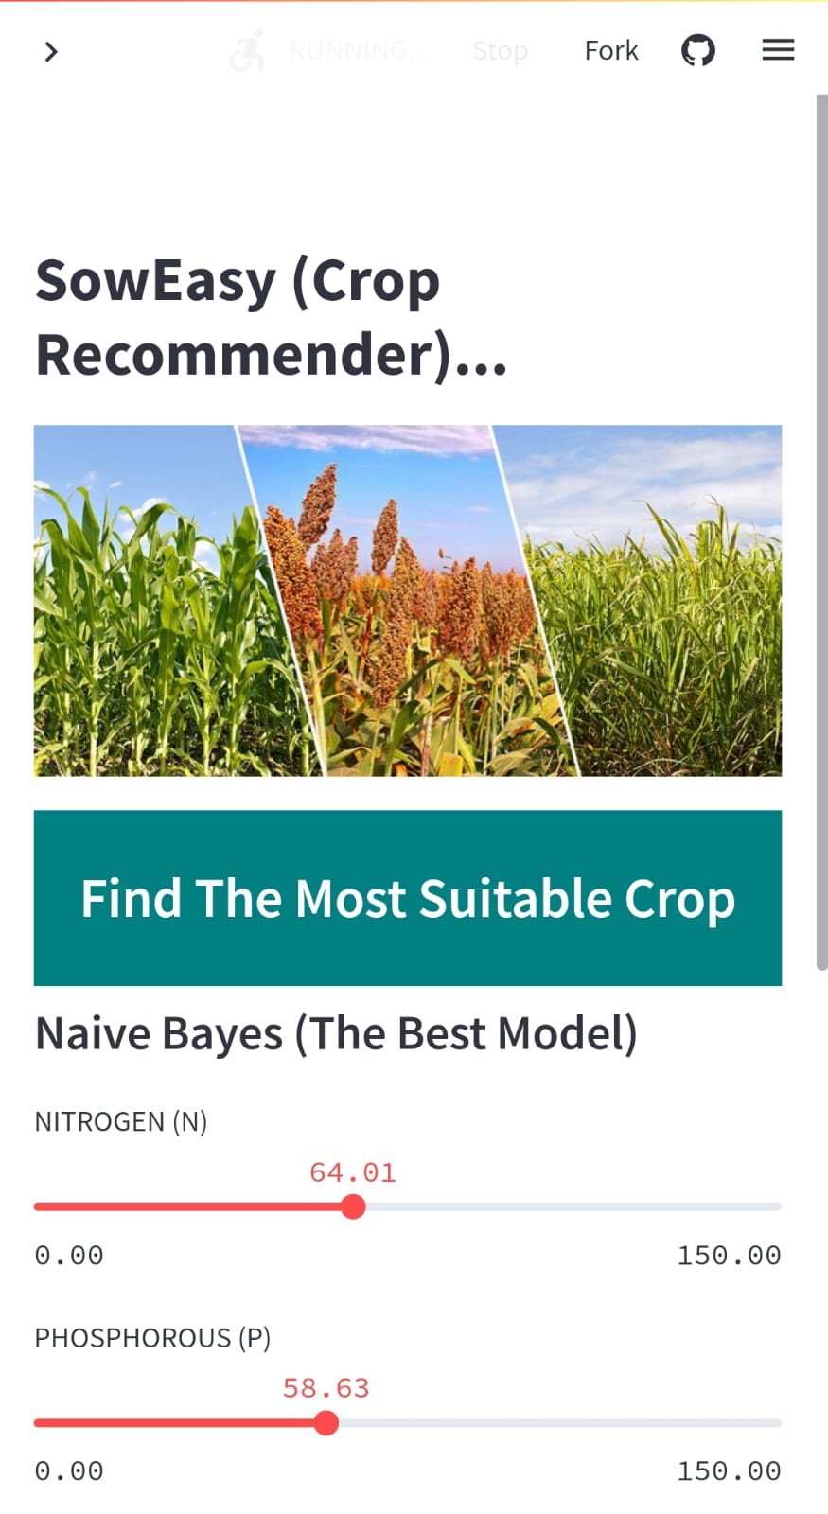
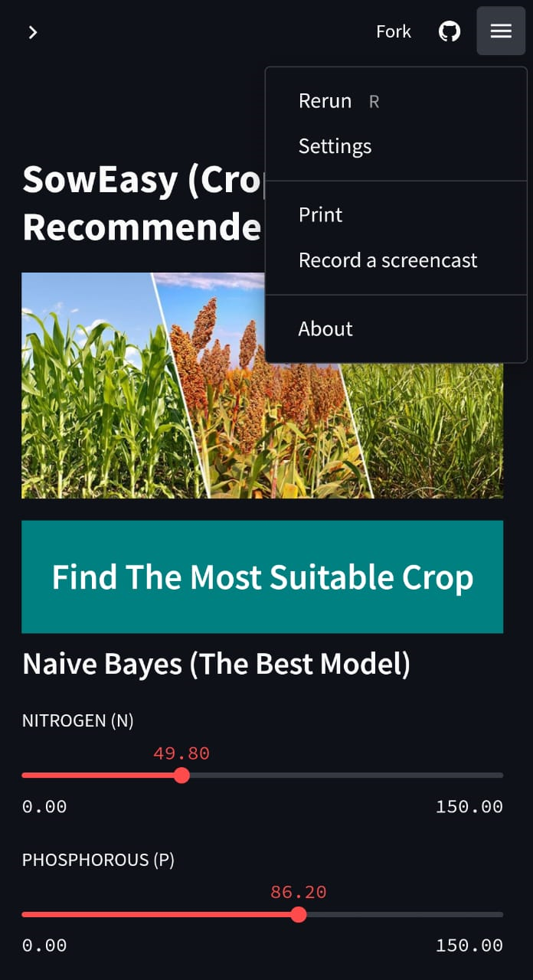
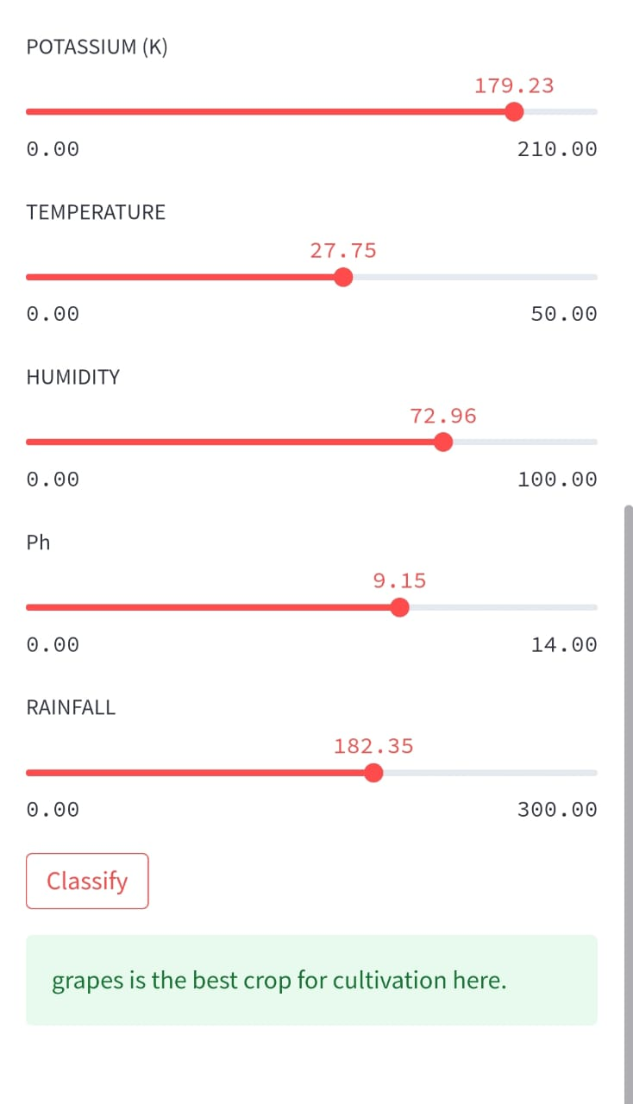
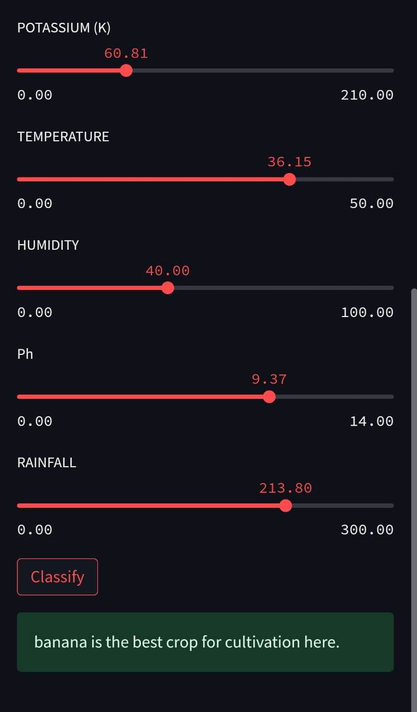
PROJECT SNAPSHOTS
Light Mode
Dark Mode

Slide 15
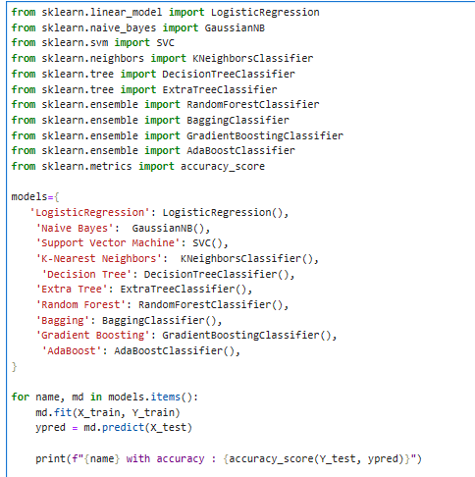
ML Model Code Snapshot

Slide 16
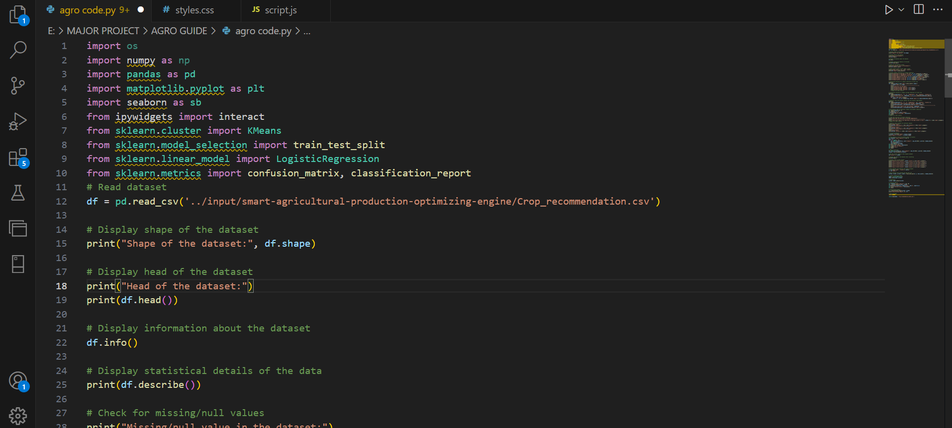
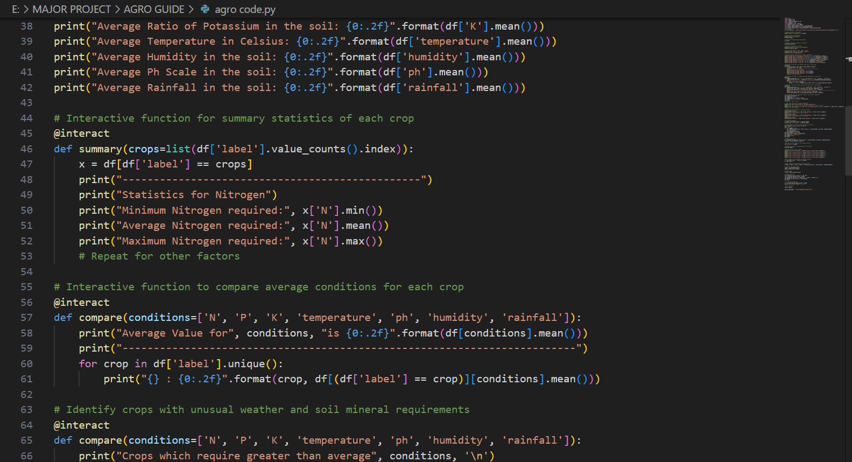
CODE SNAPSHOTS

Slide 17
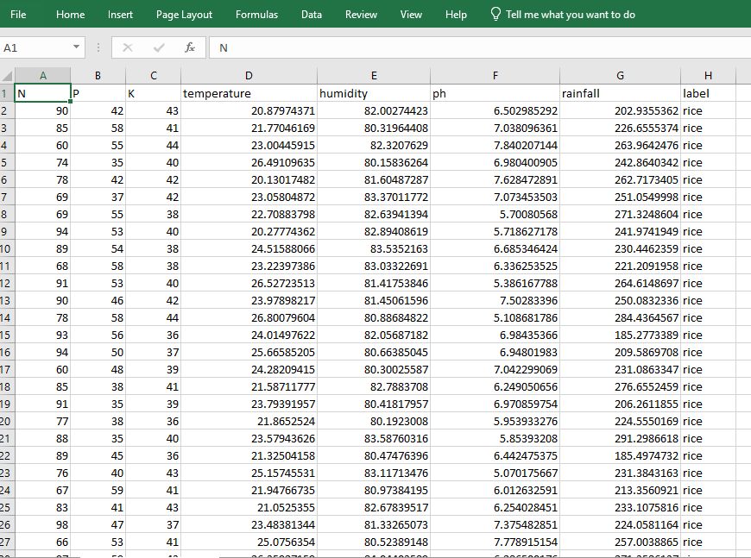
DATABASE SNAPSHOTS

Slide 18
References
https://agroguide-project.onrender.com/
https://www.kaggle.com/code/scratchpad/notebook019429f453/edit
https://www.youtube.com/
https://krishi.icar.gov.in/Technology_Database.jsp
https://flask.palletsprojects.com/
Food and Agriculture Organization. (2022). "Digital Agriculture for Sustainable Farming." FAO Digital Agriculture Report
United States Department of Agriculture. (2021). "Agricultural Statistics Annual Report." USDA Agricultural Statistics Report
Describe working by using flowchart.

Slide 19
THANK YOU

